Slide 1

Machine Learning
Lee Sutton
Jordan Lui
December 6, 2016

Slide 2
Topics
What is Machine Learning?
Types of Machine Learning
Regression
Classification
Considerations
Overfitting
Regularizing

Slide 3
Mission
In this workshop we will give you a quick demo into Machine Learning using Python

Slide 4
What is Machine Learning
Algorithms that improve performance through experience

Slide 5
What is Machine Learning
Some Terminology
Input (x). This is the input data we feed into a ML model
Target (t). These represent the “answers” to training
Weights or parameters (w)

Slide 6
Types of Machine Learning

Slide 7
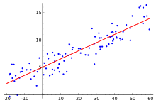
Regression
Like fitting a trendline through data points in Excel
We start with:
Some existing points
An estimate of the model structure (polynomial, sinusoid, other)
I.E. y = mx + b. More generally: y = w₀ + w₁x + w₂x² + w₃x³ + … w_{n}x^{n}
We let the ML model determine the optimal weight values to solve our system

Slide 8
Linear Regression in Scikit-Learn
Linear regression in sci kit learn
Discuss minimization of Least squared error

Slide 9
Polynomial Regression
Extend your linear model with basis functions
Replace x with phi(x)
Model is still linear with respect to the weights w
# Create a polynomial model of the data
from sklearn.preprocessing import PolynomialFeatures
poly = PolynomialFeatures(degree=3)
poly_training_features = poly.fit_transform(training_features)
# Fit your linear model with the basis functions
reg.fit(poly_training_features, training_target)

Slide 10
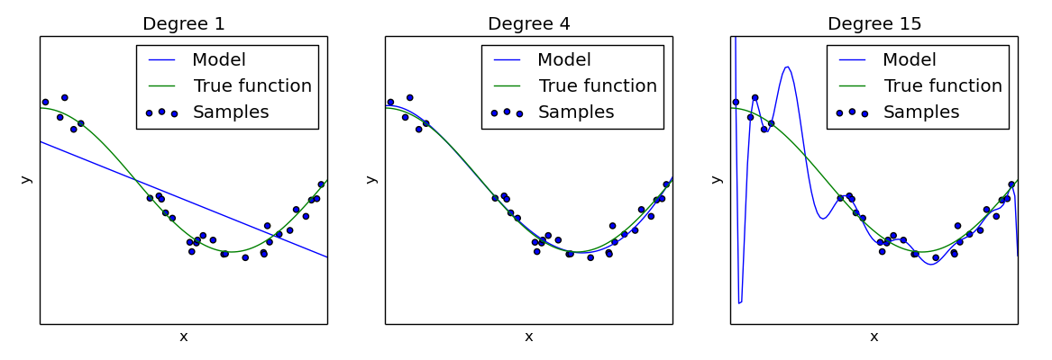
Regression: Overfitting
Why not use the highest order polynomial possible?
Overfitting!
We might fit the training data really well with a large order polynomial
However the model may perform poorly against its test data

Slide 11
Multivariate regression
Both of us look at this

Slide 12
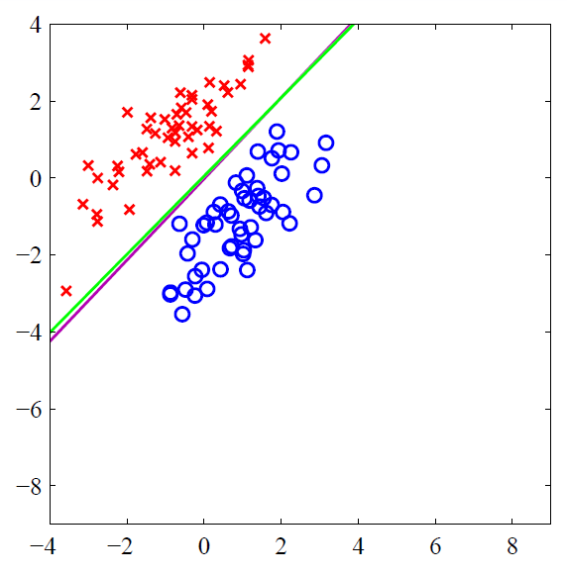
Classification
Separating points into classes
Is this image a cat or a dog?
Is this tumor sample benign or malignant?

